Slide 1
Open Government Data Activities in Japan
Document 8
May. 11, 2017
Eisaku Yamaji, Counsellor
National Strategy Office of ICT
Cabinet Secretariat

Slide 2
Outline of the Basic Act on the Advancement of Utilizing Public and Private Sector Data
The purpose of this Act is to determine the responsibilities of the State , etc. by providing for basic principles with respect to the advancement of appropriately and effectively utilizing public and private sector data (referred to as "Public and Private Sector Data Utilization"), to provide for matters that form the basis of the formulation of the Basic Plan for the Advancement of Utilizing Public and Private Sector Data and other measures, and to comprehensively and effectively promote measures for the advancement of Public and Private Sector Data Utilization by establishing the Strategic Conference for the Advancement of Utilizing Public and Private Sector Data , in consideration of the importance of further development of the environment that contributes to the solution of problems faced by Japan, such as response to the rapid progress of the declining birth rate and aging population, by appropriately and effectively utilizing a wide variety and a great deal of information that is circulated via the Internet and other advanced information and telecommunications networks, thereby contributing to the realization of a society in which the citizens are able to safely live free of anxiety and a comfortable living environment. (Article 1)
Purpose
Chapter 1 General Provisions
Chapter 2 Basic Plan for the Advancement of Utilizing Public and Private Sector Data
The term "Public and Private Sector Data" means information (*1) recorded in an electronic or magnetic record (*2), which is managed, used or provided by the State or a local public entity, or an incorporated administrative agency or any other company in performing its function or business. (Article 2)
  *2: Meaning a record which is created in electronic form, magnetic form, or any other form that cannot be perceived by the human senses
  *1: Excluding information that is likely to damage national security, inhibit the maintenance of public policy, or be an obstacle to the protection of public safety
Formulation of the Basic Plan for the Advancement of Utilizing Public and Private Sector Data by the government (Article 8)
Formulation of a prefectural plan for the advancement of utilizing public and private sector data by each prefecture (Article 9, paragraph (1))
Formulation of a municipal plan for the advancement of utilizing public and private sector data by each municipality (obligation to make efforts) (Article 9, paragraph (3))
Chapter 3 Basic Measures
Basic principles
(1) Promoting ensuring of smooth circulation of information in combination with measures under the Basic Act on the Formation of an Advanced Information and Telecommunications Network Society, etc. (Article 3, paragraph (1))
(2) Contributing to the realization of a vigorous Japanese society by promoting the formation of self-reliant and unique local communities, creation of new businesses, reinforcement of international competitiveness, etc. (Article 3, paragraph (2))
(3) Contributing to the effective and efficient promotion of administration through planning and drawing of measures based on the information obtained through Public and Private Sector Data Utilization (Article 3, paragraph (3))
(4) In advancing Public and Private Sector Data Utilization,
Security and reliability must be ensured, and the rights and interests of the citizens, national security, etc. must be kept from being damaged (Article 3, paragraph (4))
Further utilization of information and telecommunications technology in the fields that contribute to increasing convenience for citizens and administrative fields other than said fields (Article 3, paragraph (5))
Development of the foundation to ensure appropriate utilization of Public and Private Sector Data while protecting the rights and interests of the citizens (Article 3, paragraph (6))
Development of standards, securing of compatibility, and development of other foundations for ensuring coordination among a wide variety of actors (Article 3, paragraph (7))
Utilization of AI, IoT, cloud, and other advanced technology (Article 3, paragraph (8)
Establishment of online use for administrative procedures as a principle and promotion of online use for procedures of private companies, etc. (Article 10)
Advancement of utilizing Public and Private Sector Data held by the State, local public entities, and companies by themselves, etc. and review of related systems (including increase in the smoothness of circulation of content) (Article 11)
Building of a mechanism for the participation of individuals in data circulation, etc. for the purpose of promoting the smooth circulation of Public and Private Sector Data (Article 12)
Rectification of the disparity among citizens in their opportunities for using information and telecommunications technology or their ability to utilize it, which arises from geographical constraints, age, and other elements (Article 14)
Development of standards for information systems, securing of compatibility among those systems, review of business, and development of the foundation for ensuring coordination among the information systems of public and private sectors (service platform) (Article 15)
Ensuring of consistency between the State's measures and local public entities' measures (Article 19)
In addition, use of Individual Number Cards (Article 13), promotion of research and development, etc. (Article 16), development and securing of human resources (Article 17), and promotion of education and learning, dissemination and enlightenment, etc. (Article 18)
Chapter 4 Strategic Conference for the Advancement of Utilizing Public and Private Sector Data
情報利用開発等事業者
Establishment of the Strategic Conference for the Advancement of Utilizing Public and Private Sector Data under the Strategic Headquarters for the Promotion of an Advanced Information and Telecommunications Network Society (Article 20)
Organization of the Strategic Conference for the Advancement of Utilizing Public and Private Sector Data (the chairperson is the Prime Minister) (Articles 22 and 23)
Formulation of a draft plan and development of a system for implementation of measures based on the plan, etc. (designation of priority fields and recommendation to the head of the relevant administrative organ, etc. by the chairperson) (Articles 20 to 28)
Cooperation for Local Public Entities (Article 27)
Responsibilities of the State, Local Public Entities, and Companies (Articles 4 to 6)
Legislative measures, etc. (Article 7)
Supplementary Provisions
The effective date is the date of promulgation. (Paragraph (1) of the Supplementary Provisions)
State's cooperation for local public entities to contribute to the smooth enforcement of this Act (Paragraph (2) of the Supplementary Provisions)

Slide 3
Chapter 3 Basic Measures
Easy Use of Public and Private Sector Data held by the State and Local Public Entities, etc. （Article 11 (1)(2)）
（Easy Use of Public and Private Sector Data Held by the State and Local Public Entities, etc.）
Article 11 (1) The State and local public entities are to implement necessary measures to enable citizens to easily use Public and Private Sector Data held by themselves via the Internet or any other advanced information and telecommunications network while ensuring that the rights and interests of individuals and corporations, national security, etc. are not damaged.
(2) Companies are to endeavor to implement necessary measures to enable citizens to easily use Public and Private Sector Data held by themselves, which contributes to enhancing public interest, via the Internet or any other advanced information and telecommunications network while ensuring that the rights and interests of individuals and corporations, national security, etc. are not damaged.
○The State and local public entities: obligation to implement necessary measures.
○Companies: obligation to make efforts to implement necessary measures with regards to data which contribute to enhancing public interest.
○Japan has been promoting Open Government Data that are publicized with machine-readable format and can be used freely in accordance with Japan Government Standard Term of Use 2.0 which is compatible with 4.0 CC-BY.
○Over 240 out of 1788 local public entities have been implementing Open data initiatives. (December, 2017 according to the survey by Office of IT, Cabinet Secretariat)

Slide 4

Outline of “Growth Strategy Council -Investing for the Future” (December 19, 2016)
○Prime Minister's remark
“Under the Basic Act on the Advancement of Utilizing Public and Private Sector, which took effect last week, we will continue to strongly promote open data while paying attention to personal information, safety and security. Under the IT Strategy Headquarters, we will establish a control tower consisting of public and private experts, and we will set priority areas according to the needs of the private sector, and we will implement necessary measures with a period of intensive work until 2020. I would like to ask the related Ministers to study and implement the concrete measures and timeline proposed by the Council Members.
(Reference) Concrete measures proposed by Council Member
· The 2020 Tokyo Olympic and Paralympic Games
(Traffic information, etc.)
· Automated driving maps so called “Dynamic Map” (static digital map with real time information of traffic conditions, road construction and etc.)
3

Slide 5
The Number of Local Governments Publishing Open Data
Term | Municipalities ( out of 1788 ) | Prefectures ( out of 47) | Total
Mar 2014 | 24 | 6 | 30
Feb 2015 | 87 | 16 | 103
Jun 2015 | 132 | 22 | 154
Mar 2016 | 176 | 29 | 205
Sep 2016 | 199 | 34 | 233
Dec 2016 | 208 | 34 | 242
Feb 2017 | 233 | 34 | 267
（Based on investigation by National Strategy Office of ICT, Government of Japan）
“Local governments publishing open data” means municipalities or prefectures are publishing their data as open data with appropriate terms and conditions, or describe information of their open data and the site publishing them on their websites.

Slide 6
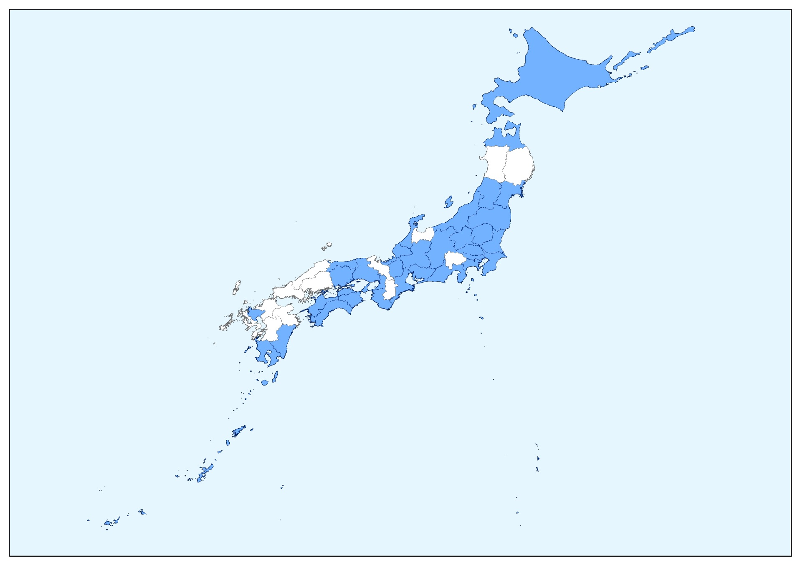
The Map of Local Governments Publishing Open Data
Prefectures

Slide 7
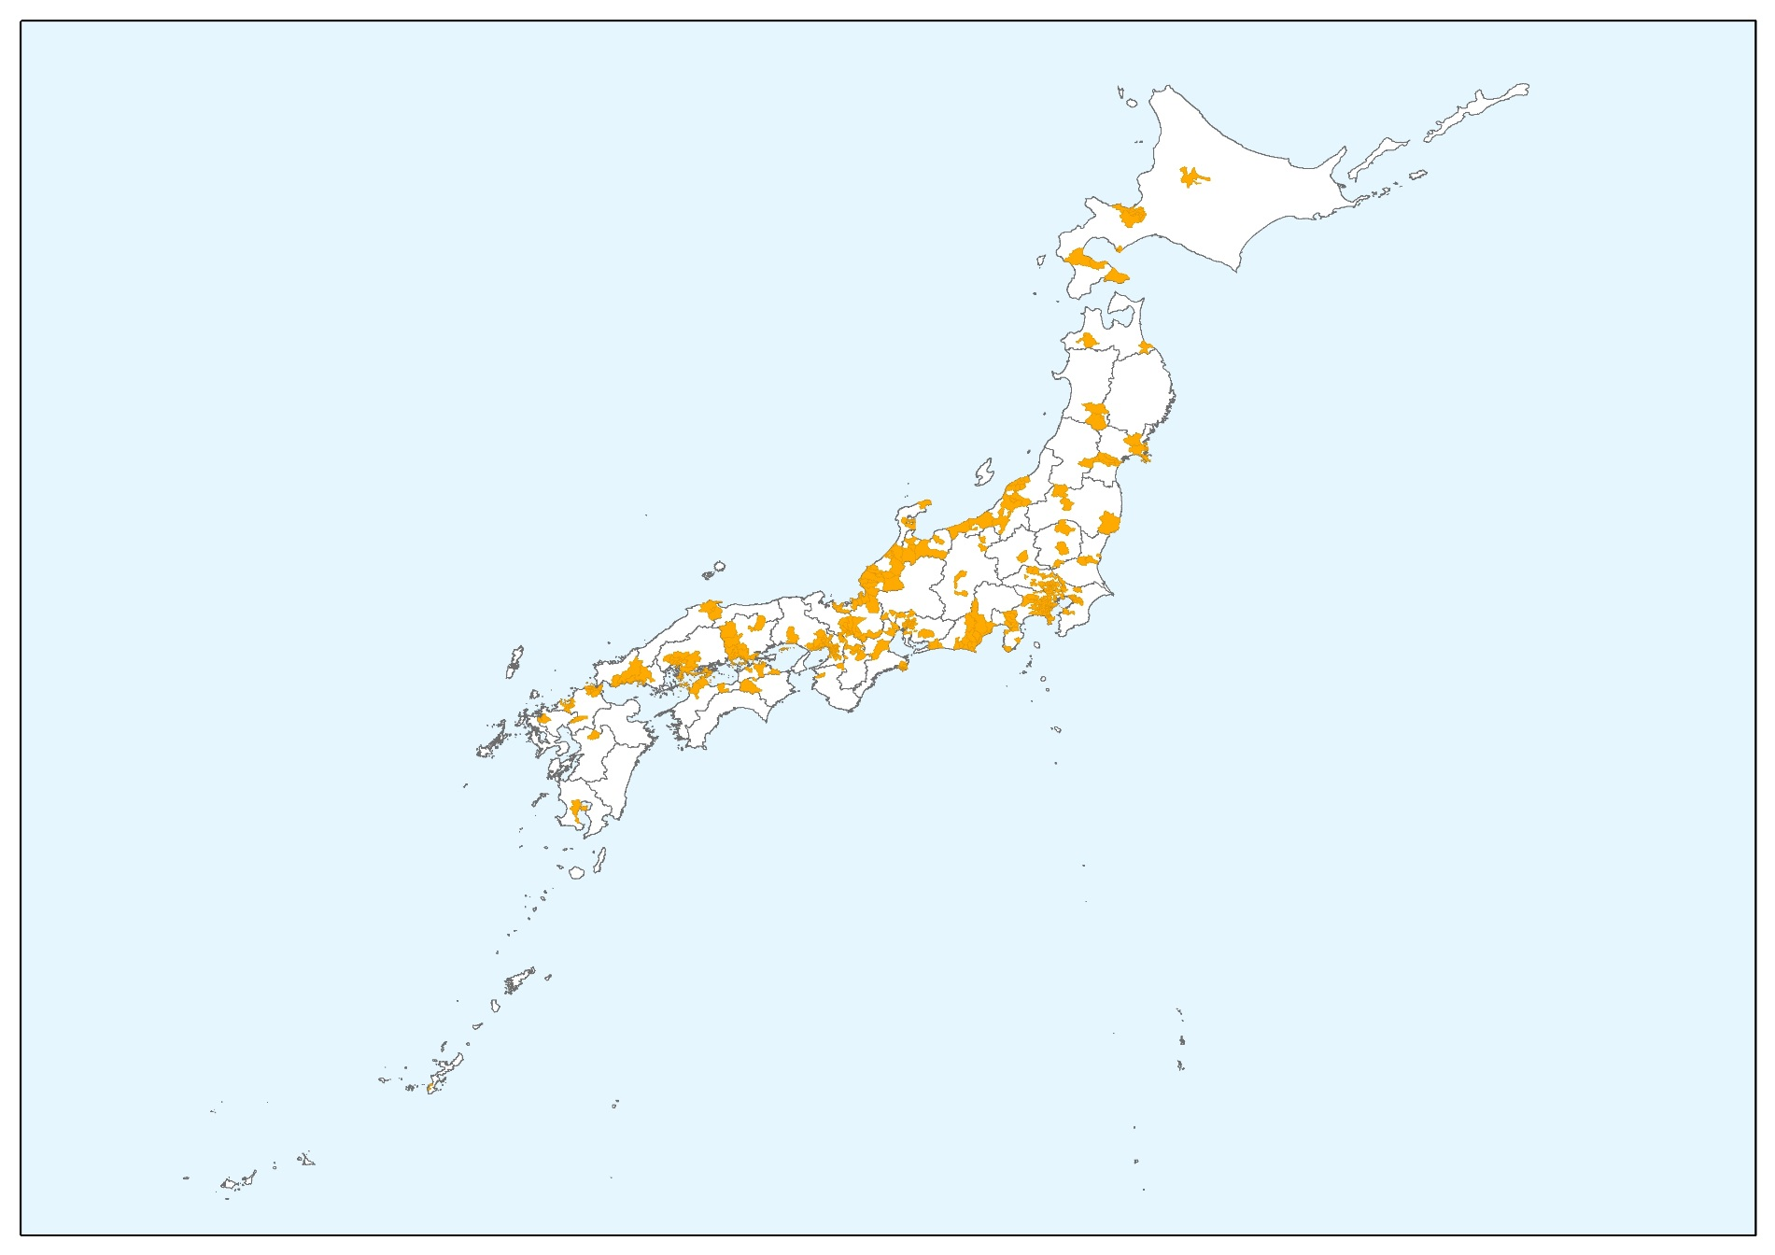
The Map of Local Governments Publishing Open Data
Municipalities

Slide 8

Open Data Evangelists
Last year, Government of Japan appointed eight experts as “Open Data Evangelists” and started to send them to local governments.
Each evangelist promotes the utilization of Open Data and helps local governments set up Open Data portal sites together with “Open Data Guideline and handbook for local government”, where national initiatives are summarized, “Open Data Package for Local Governments” and “Open Data 100 (Use Case)”.
Open Data
Evangelists
Local Government
Local Government
Local Government
Guideline
Package
OD100

Slide 9


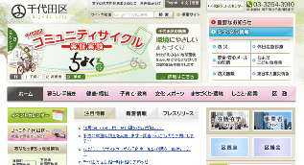
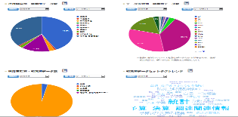



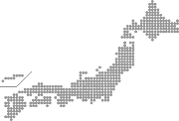
Open Data Package for Local Governments
Provide Package to Accelerate the Action of Open Data in Local Governments
To support local governments that do not know how to take a first step toward open data, Government of Japan provide package that consists of open data catalogue and dashboard application using open data. The Government assist local governments to accelerate open data activities by utilizing the Open Data Package .
Package Contents
Included in this package
・Data Catalogue for open data
・Dashboard using open data
Resident
Additional
Camera on street
Normal time: Normal information
Disaster: Show alert / evacuation
route
Effect expected
・Help solve problems faced by regional public bodies by opening data related to regional issues such as disaster prevention, decreasing birthrate and aging society etc.
・Make it easier to start open data by providing package focusing both on the availability and the use of data
・ Provide example of standard format for registering data
Regional Public body’s HP
Real-time transportation
Information
Dashboard
Pick up data
Register data
Index
Staff
data
Map(GIS Information)
Data Catalog Site/
Dashboard
    ⇨Translating into English to deploy globally.

